Slide 1
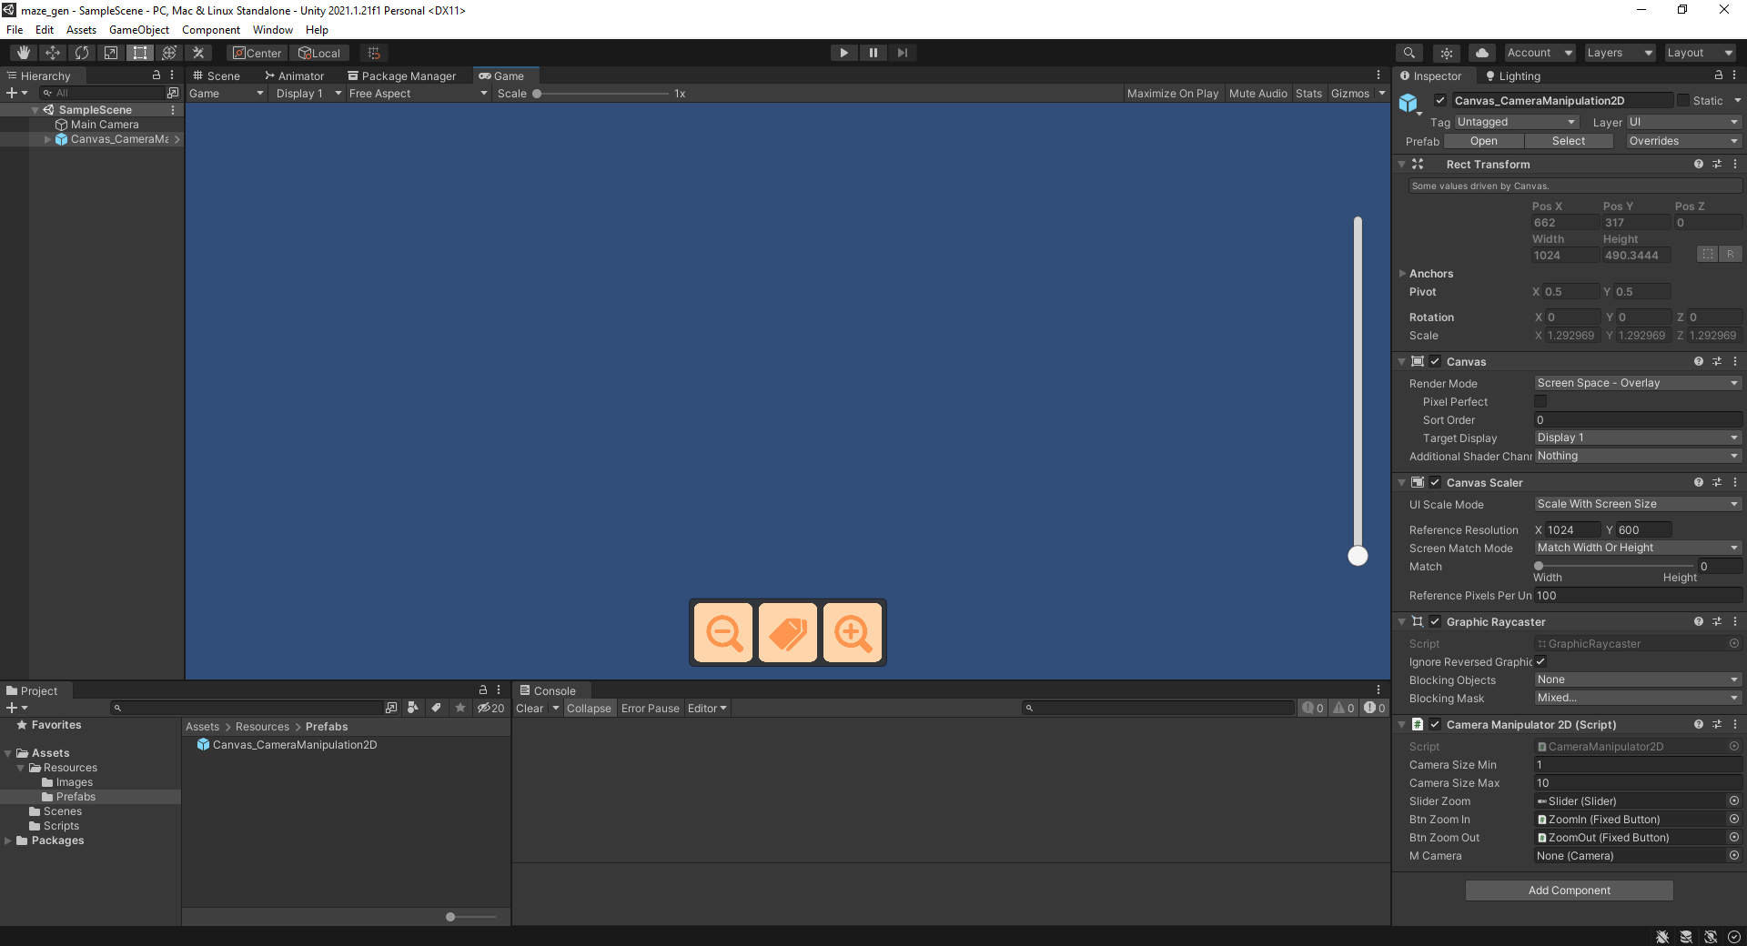

Slide 2


Slide 3

UP
LEFT
RIGHT
DOWN

Slide 4
UP
UP
LEFT
RIGHT
LEFT
RIGHT
DOWN
DOWN

Slide 5


Slide 6
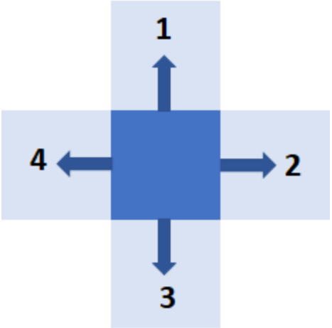

Slide 7
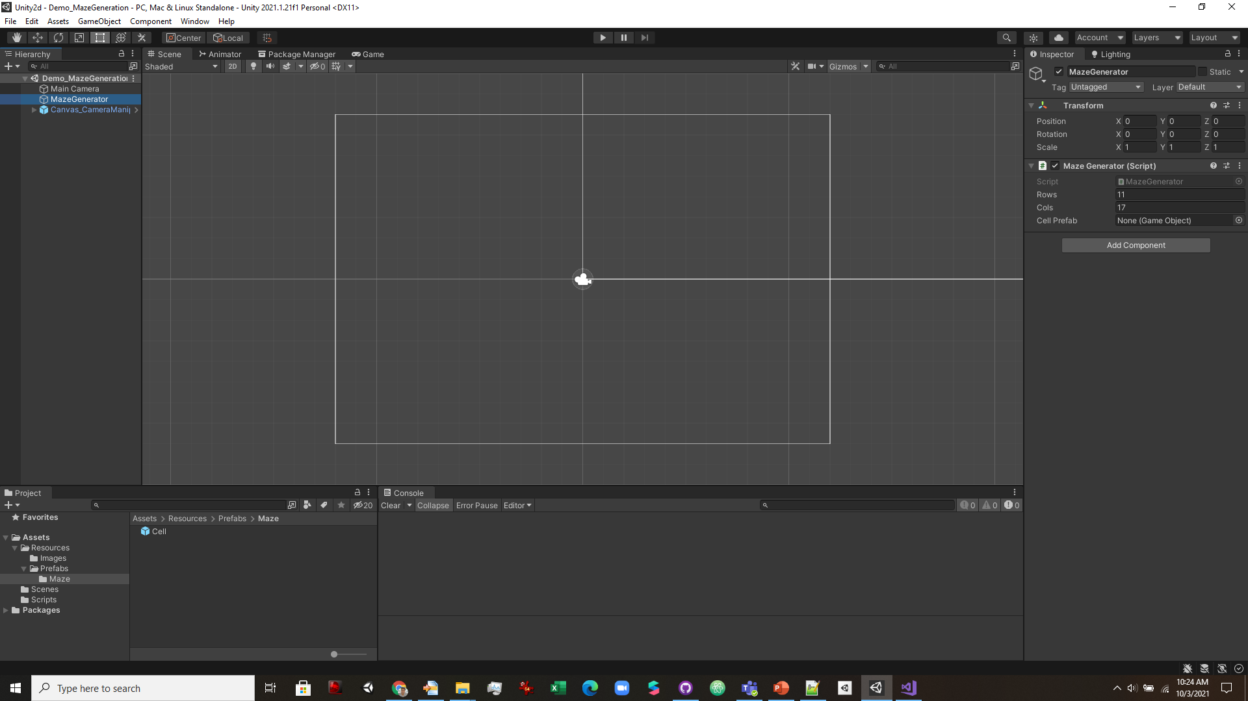

Slide 8
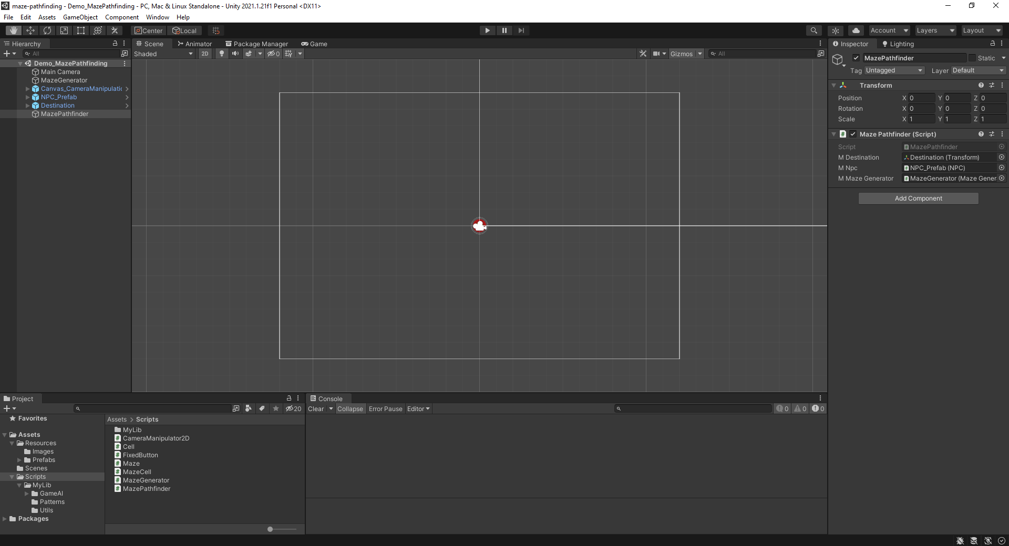

Slide 9
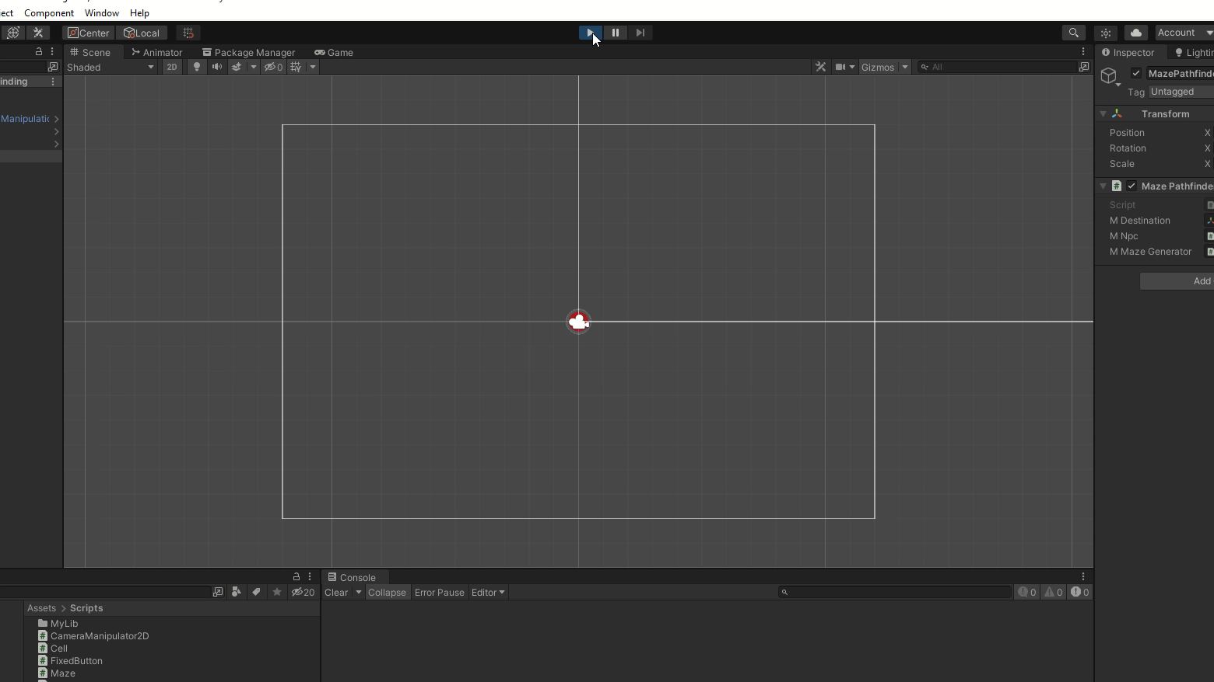

Slide 10
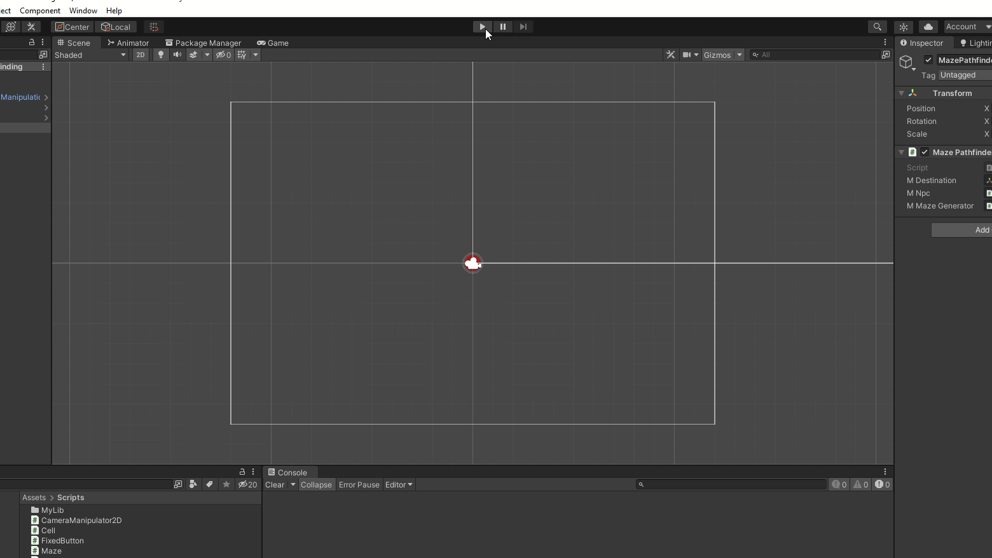

Slide 11
